Slide 1
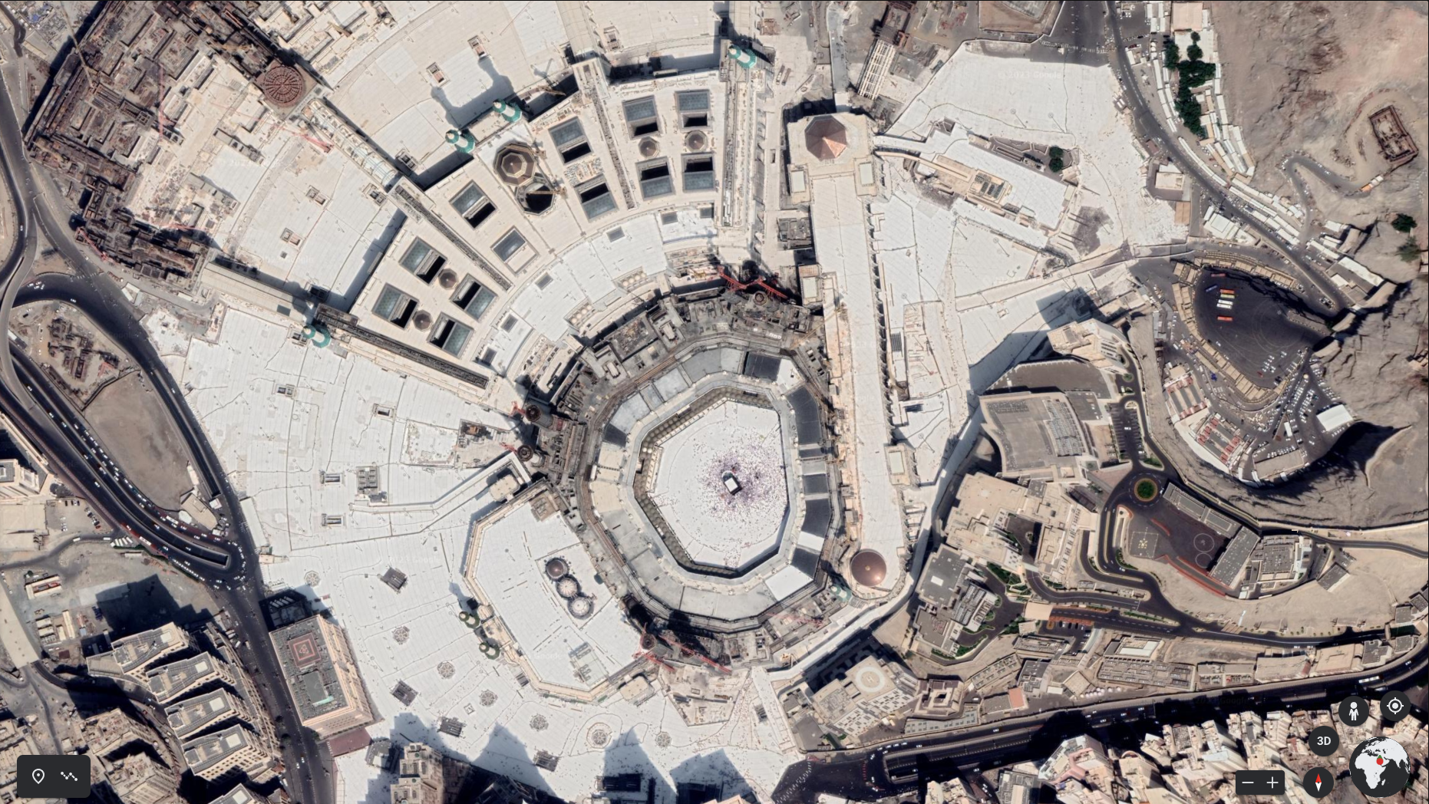

Slide 2
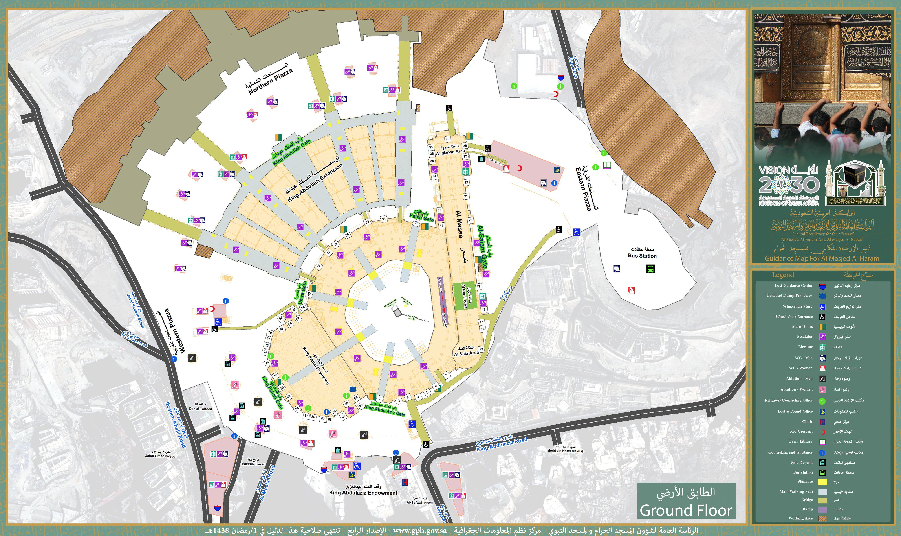

Slide 3
MARWA
5
6
8
9
 | Pray Location
 | Pathway
 | Tawaf Sahan
7
12
4
11
10
1
King Fahd Extension
2
Saudi Portico
6
10
3
Masaa
2
9
13
7
3
5
8
SAFA
1
4
3
1
2
1
3
2

